Slide 1

STATE OF ALABAMA
OFFICE OF INFORMATION TECHNOLOGY
IT Project Governance
Dr. Joanne Hale, Secretary of IT
Cheri Martin, Deputy Secretary of IT
Lisa Townsend, DHR CIO

Slide 2
Mission of OIT
State level
Policy
Planning
Governance

Slide 3
Agenda
IT Project Governance
  What it is
  Why we need it
Who developed it
How it works
Where to find more details
How to get started

Slide 4
What is IT Project Governance
Guides how project decisions are made
Who
How
When

Slide 5
Why IT Project Governance
Mutual project goals
  Establish
  Ensure they are met
Minimize risk
Resolve conflicts
Align with strategic direction
Maximize statewide benefit from technology investments

Slide 6
Policy Development:
Project Governance Workgroup
Agency IT Leaders and Project Managers
Established in 2014
Studied Governance drivers and best practices
Drafted policies
  Reviewed with the Agency CIO Council
  Refined based on feedback

Slide 7
OIT Project Governance Workgroup
Lisa Townsend (Chairman), Dept. Human Resources
Effie Brown, Dept. of Insurance
Joel Cook, Finance ISD
Paul Scott, Dept. of Transportation
Clay Weaver, Rehabilitation Services
Rodney Zeigler, Dept. of Labor
Jeff Barnes, Dept. Human Resources

Slide 8
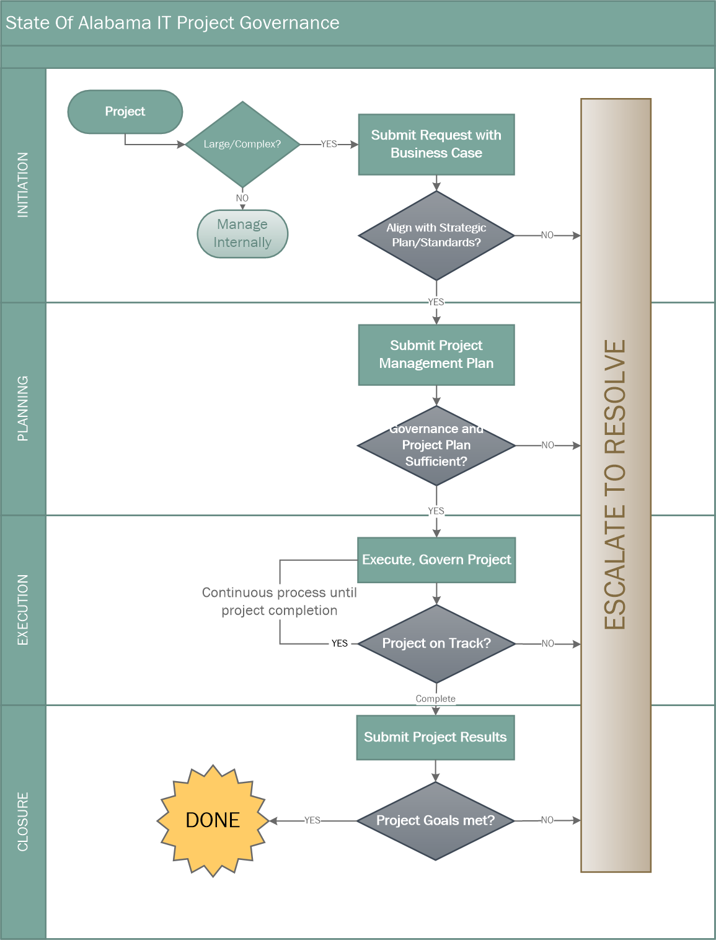
Overview of IT Project Governance

Slide 9
Project Threshold
Total cost exceeds $1 million
or
Multi-agency - Total cost exceeds $500,000
or
By request

Slide 10
Project Sizing
Determined by tool
Moderate
  Less documentation required
Major
  Larger
  More complex

Slide 11
Overview of IT Project Governance

Slide 12
Initiation Phase
Project Request
Business Case
Cost Benefit Analysis

Slide 13
Overview of IT Project Governance

Slide 14
Planning Phase
Project Management Plan
More than a schedule
Scope
Project Approach
Communication Plan
Milestones
Cost estimate
Value realization

Slide 15
Overview of IT Project Governance

Slide 16
Execution Phase
Status Report
Regular Project Meetings
How will OIT be involved?
  Monitoring via status report
  Engagement level determined by project need/risk

Slide 17
Overview of IT Project Governance

Slide 18
Closure Phase
Project Closure Report
  Acceptance of project results
  Lessons Learned
  Resources released
Benefit Realization Reports
  Start when any part of project is implemented
  End when expected benefits are achieved

Slide 19
IT Project Governance Policies
  400 – IT Project Governance
  410 – IT Project Initiation
  420 – IT Project Planning
  430 – IT Project Execution and Control
  440 – IT Project Closure

Slide 20
OIT Governance Library
Policies
  400 – IT Project Governance
    Guidelines
      400G1 – IT Project Governance
    Standards
      400S1 – IT Project Governance Threshold
    Templates
      400T1 – OIT Notification Template
    Procedures
      400P1 – Completing an OIT Notification Template
      400P2 – IT Project Tailoring
Found on the IT Governance Library page of the OIT website oit.Alabama.gov

Slide 21
Getting Started
Read the Guideline with the Policy first
Initiation Phase
  Tool to assist
Call OIT for clarification
Initially submit through email to InfoOIT@oit.Alabama.gov
SharePoint site coming soon

Slide 22
QUESTIONS?

